Slide 1
The Error of Balaam
An Excursus of Jude 11b
October 23, 2022

Slide 2
Jude 11
Woe to them! For they have gone the way of Cain, and for pay they have rushed headlong into the error of Balaam, and perished in the rebellion of Korah.

Slide 3
Apostasy
General definition: any falling away from the truth and will of God.
For even though they knew God, they did not honor Him as God or give thanks, but they became futile in their speculations, and their foolish heart was darkened. (Romans 1:21)
and although they know the ordinance of God, that those who practice such things are worthy of death, they not only do the same, but also give hearty approval to those who practice them. (Romans 1:32)

Slide 4
Apostasy
General definition: any falling away from the truth and will of God.
Technical definition (two aspects):
A falling away from key and true doctrines of the Bible into heretical teachings that claim to be “the real” Christian doctrine.
A complete renunciation of the Christian faith, which results in a full abandonment of Christ.

Slide 5
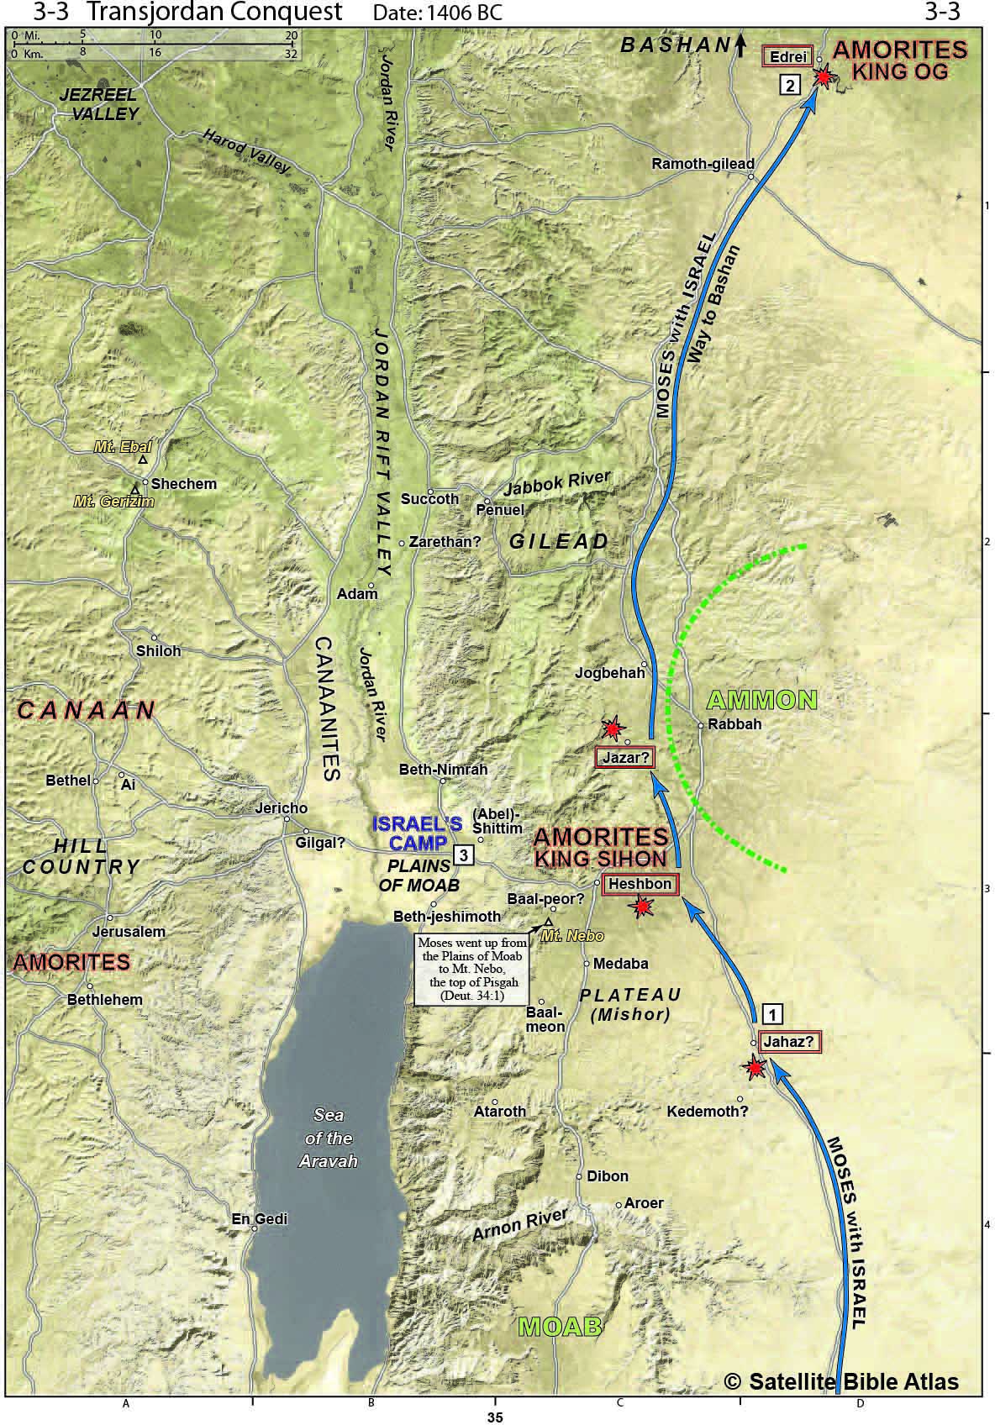
Jude 11

Slide 6
Deuteronomy 18:10-11
10 There shall not be found among you anyone who makes his son or his daughter pass through the fire, one who uses divination, one who practices witchcraft, or one who interprets omens, or a sorcerer, 11 or one who casts a spell, or a medium, or a spiritist, or one who calls up the dead.

Slide 7
The Error of Balaam
Balaam’s motivation
The error of Balaam = the pursuit of money, power, or prestige
forsaking the right way, they [apostates] have gone astray, having followed the way of Balaam, the son of Beor, who loved the wages of unrighteousness (2 Peter 2:15)

Slide 8
Numbers 22:12
God said to Balaam, “Do not go with them; you shall not curse the people, for they are blessed.”

Slide 9
The Error of Balaam
Balaam’s messages
Balaam’s first message – separation (Numbers 23:7-10)
7 He [Balaam] took up his discourse and said, “From Aram Balak has brought me, Moab's king from the mountains of the East, ‘Come curse Jacob for me, And come, denounce Israel!’ 8 How shall I curse whom God has not cursed? And how can I denounce whom the Lord has not denounced? 9 As I see him from the top of the rocks, And I look at him from the hills; Behold, a people who dwells apart, And will not be reckoned among the nations. 10 Who can count the dust of Jacob, Or number the fourth part of Israel? Let me die the death of the upright, And let my end be like his!”

Slide 10
The Error of Balaam
Balaam’s messages
Balaam’s second message – justification (Numbers 23:19-24)
19 God is not a man, that He should lie, Nor a son of man, that He should repent; Has He said, and will He not do it? Or has He spoken, and will He not make it good?
20 Behold, I have received a command to bless; When He has blessed, then I cannot revoke it. 21 He has not observed misfortune in Jacob; Nor has He seen trouble in Israel; The Lord his God is with him, And the shout of a king is among them.

Slide 11
Romans 8:33
Who will bring a charge against God's elect? God is the one who justifies;

Slide 12
The Error of Balaam
Balaam’s messages
Balaam’s third message – sanctificatino (Numbers 24:2-9)
8 God brings him out of Egypt, He is for him like the horns of the wild ox. He will devour the nations who are his adversaries, And will crush their bones in pieces, And shatter them with his arrows. 9 He couches, he lies down as a lion, And as a lion, who dares rouse him? Blessed is everyone who blesses you, And cursed is everyone who curses you.

Slide 13
Numbers 21:6-9
6 The Lord sent fiery serpents among the people and they bit the people, so that many people of Israel died. 7 So the people came to Moses and said, "We have sinned, because we have spoken against the Lord and you; intercede with the Lord, that He may remove the serpents from us." And Moses interceded for the people. 8 Then the Lord said to Moses, "Make a fiery serpent, and set it on a standard; and it shall come about, that everyone who is bitten, when he looks at it, he will live." 9 And Moses made a bronze serpent and set it on the standard; and it came about, that if a serpent bit any man, when he looked to the bronze serpent, he lived.

Slide 14
John 3:14-17
14 As Moses lifted up the serpent in the wilderness, even so must the Son of Man be lifted up; 15 so that whoever believes will in Him have eternal life. 16 For God so loved the world, that He gave His only begotten Son, that whoever believes in Him shall not perish, but have eternal life. 17 For God did not send the Son into the world to judge the world, but that the world might be saved through Him.

Slide 15
The Error of Balaam
Balaam’s messages
Balaam’s fourth message – exaltation (Numbers 24:15-24)
16 The oracle of him who hears the words of God, And knows the knowledge of the Most High, Who sees the vision of the Almighty, Falling down, yet having his eyes uncovered. 17 "I see him, but not now; I behold him, but not near; A star shall come forth from Jacob, A scepter shall rise from Israel, And shall crush through the forehead of Moab, And tear down all the sons of Sheth…19 One from Jacob shall have dominion, And will destroy the remnant from the city.

Slide 16
The Error of Balaam
Balaam’s manipulation
But I have a few things against you, because you have there some who hold the teaching [doctrine] of Balaam, who kept teaching Balak to put a stumbling block before the sons of Israel, to eat things sacrificed to idols and to commit acts of immorality. (Revelation 2:14)

Slide 17
Hebrews 10:26-27
26 For if we go on sinning willfully after receiving the knowledge of the truth, there no longer remains a sacrifice for sins, 27 but a terrifying expectation of judgment and THE FURY OF A FIRE WHICH WILL CONSUME THE ADVERSARIES.

Slide 18
The Error of Balaam
An Excursus of Jude 11b
October 23, 2022

